Slide 1
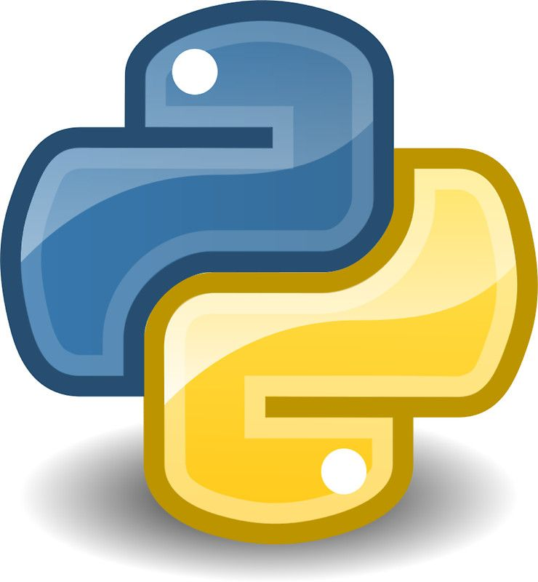
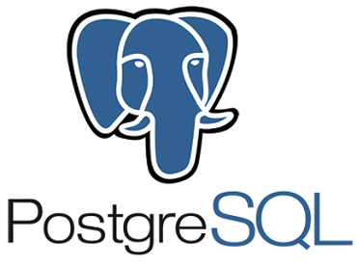
Python & PostgreSQL
Better
Together
Bryan Cafferky
Data & AI Enabler

Slide 2
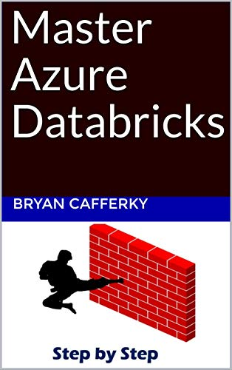
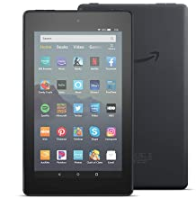
Apache Spark Based Service
Comprehensive Resource
From Beginner to Expert
Step by Step Use Case
Free Kindle Reader for most devices
Available on Amazon!

Slide 3

Where Are We Going?
What is PostgreSQL?
Why Use PostgreSQL with Python?
Riveting Demo
To get PostgreSQL:
https://www.postgresql.org/download/
Sample Database:
https://www.postgresqltutorial.com/postgresql-sample-database/

Slide 4

What is PostgreSQL?
Free and Truly Open-Source Enterprise Database Management System
Very Performant
Supports Large Databases
Features Competitive with Oracle and SQL Server
Resiliency and High Availability
Runs on many platforms

Slide 5

PostgreSQL/Python Features
PostgreSQL is the Python Community's Favorite Database
Several ways to use it.
ODBC
PostgreSQL Drivers
SQLAlchemy
pandas
Integration with pandas simplifies things.

Slide 6
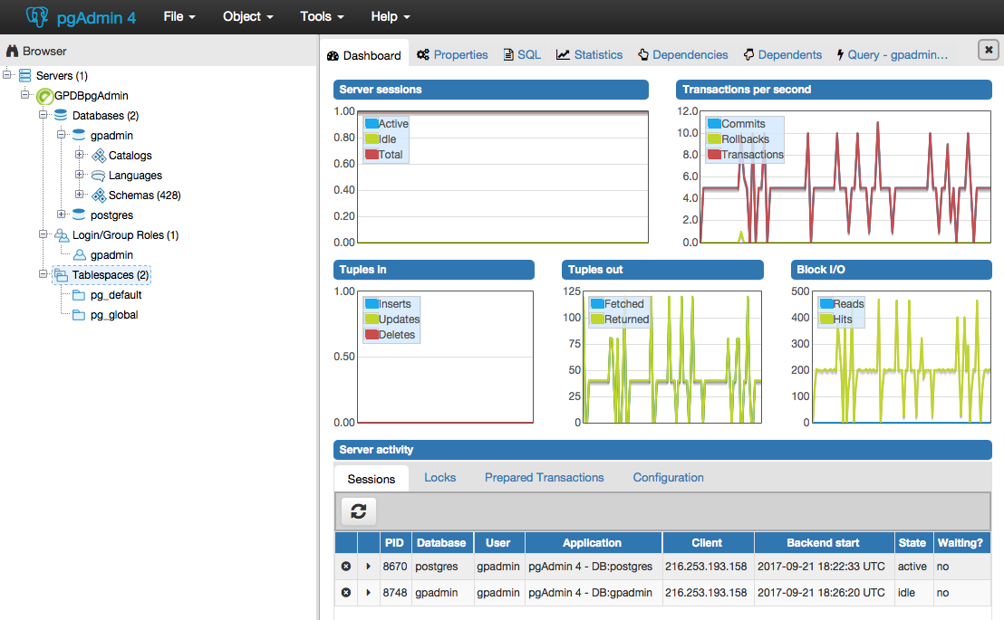
pgAdmin

Slide 7

Demo Time!
https://pixabay.com/photos/elephant-animals-asia-large-1822636/
Notebook and data available at github.com/bcafferky/shared
Folder: PostgreSQLPython

Slide 8
Wrapping Up
What is PostgreSQL?
Why Use PostgreSQL with Python?
Riveting Demo
Thank You!

